Slide 1
Using a Stack to SOLVE
  Checking for Balanced Delimiters in an Infix Algebraic Expression
  Transforming an Infix Expression to a Postfix Expression
  Evaluating Postfix Expressions
  Evaluating Infix Expressions

Slide 2
Using a Stack to Process Algebraic Expressions
Algebraic expressions composed of
  Operands (variables, constants)
  Operators (+, -, /, *, ^)
Operators can be unary or binary
Different precedence notations
  Infix a + b
  Prefix + a b
  Postfix a b +

Slide 3
Using a Stack to Process Algebraic Expressions
Precedence must be maintained
  Order of operators
  Use of parentheses (must be balanced)
Use stacks to evaluate parentheses usage
  Scan expression
  Push symbols
  Pop symbols

Slide 4
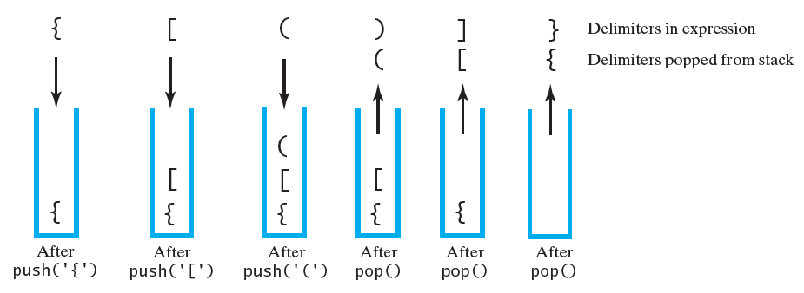
The contents of a stack during the scan of an expression that contains the balanced delimiters { [ ( ) ] }
  Checking for Balanced Delimiters in an Infix Algebraic Expression

Slide 5
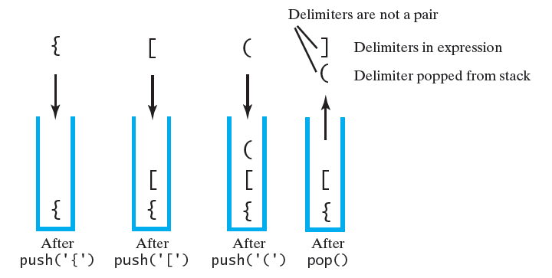
The contents of a stack during the scan of an expression that contains the unbalanced delimiters { [ ( ] ) }

Slide 6
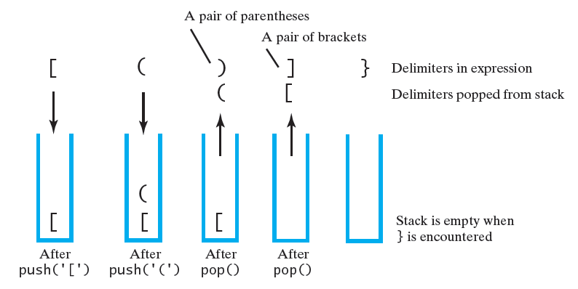
The contents of a stack during the scan of an expression that contains the unbalanced delimiters [ ( ) ] }

Slide 7
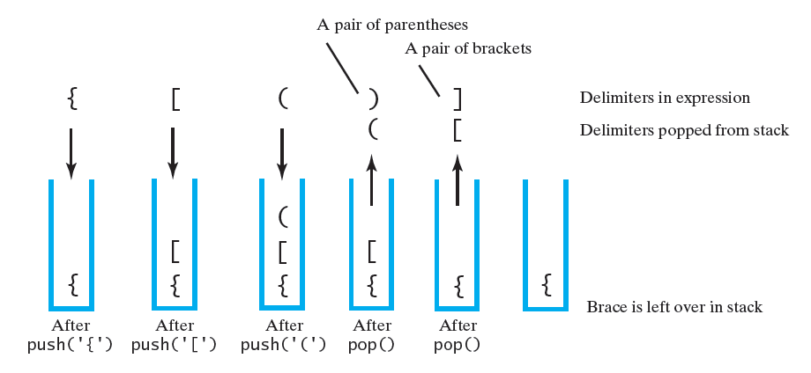
The contents of a stack during the scan of an expression that contains the unbalanced delimiters { [ ( ) ]

Slide 8
2. Transforming an Infix Expression to a Postfix Expression
Manual algorithm for converting infix to postfix (a + b) * c
  Write with parentheses to force correct operator precedence ((a + b) * c)
  Move operator to right inside parentheses
  ((a b + ) c * )
  Remove parentheses
  a b + c *

Slide 9
Infix to Postfix
Algorithm basics
  Scan expression left to right
  When operand found, place at end of new expression
  When operator found, save to determine new position

Slide 10
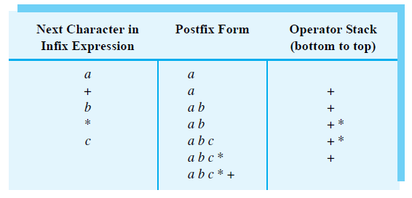
Converting the infix expression a + b * c to postfix form

Slide 11
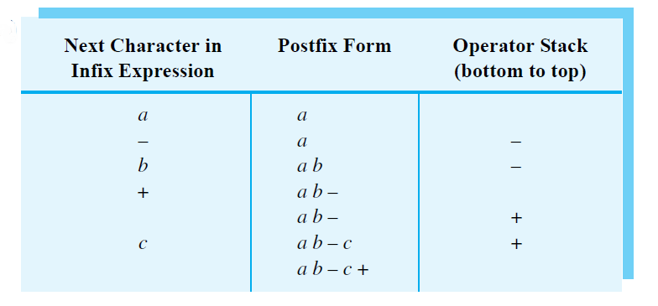
Converting an infix expression to postfix form: a - b + c

Slide 12
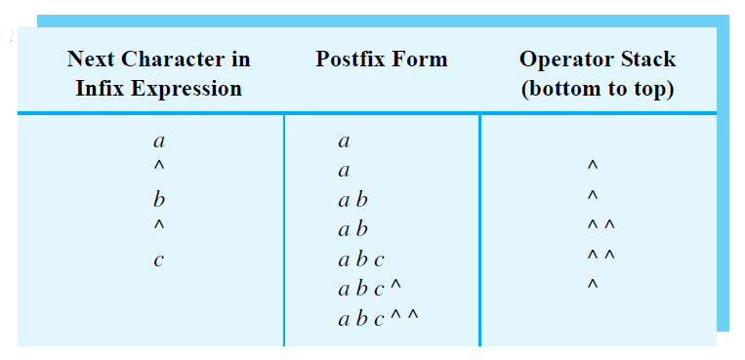
Converting an infix expression to postfix form: a ^ b ^ c

Slide 13
Infix to Postfix Conversion
Operand
  Append to end of output expression
Operator ^
  Push ^ onto stack
Operators +, -, *, /
  Pop from stack, append to output expression
  Until stack empty or top operator has lower precedence than new operator
  Then push new operator onto stack

Slide 14
Infix to Postfix Conversion
Open parenthesis
  Push ( onto stack
Close parenthesis
  Pop operators from stack and append to output
  Until open parenthesis is popped.
  Discard both parentheses

Slide 15

Infix to postfix conversion
infixVect
( a + b - c ) * d – ( e + f )
postfixVect

Slide 16
Infix to postfix conversion
infixVect
a + b - c ) * d – ( e + f )
postfixVect
(

Slide 17
Infix to postfix conversion
infixVect
+ b - c ) * d – ( e + f )
postfixVect
a
(

Slide 18
Infix to postfix conversion
infixVect
b - c ) * d – ( e + f )
postfixVect
a
+
(

Slide 19
Infix to postfix conversion
infixVect
- c ) * d – ( e + f )
postfixVect
a b
+
(

Slide 20
Infix to postfix conversion
infixVect
c ) * d – ( e + f )
postfixVect
a b +
-
(

Slide 21
Infix to postfix conversion
infixVect
) * d – ( e + f )
postfixVect
a b + c
-
(

Slide 22
Infix to postfix conversion
infixVect
* d – ( e + f )
postfixVect
a b + c -

Slide 23
Infix to postfix conversion
infixVect
d – ( e + f )
postfixVect
a b + c -
*

Slide 24
Infix to postfix conversion
infixVect
– ( e + f )
postfixVect
a b + c - d
*

Slide 25
Infix to postfix conversion
infixVect
( e + f )
postfixVect
a b + c – d *
-

Slide 26
Infix to postfix conversion
infixVect
e + f )
postfixVect
a b + c – d *
(
-

Slide 27
Infix to postfix conversion
infixVect
+ f )
postfixVect
a b + c – d * e
(
-

Slide 28
Infix to postfix conversion
infixVect
f )
postfixVect
a b + c – d * e
+
(
-

Slide 29
Infix to postfix conversion
infixVect
)
postfixVect
a b + c – d * e f
+
(
-

Slide 30
Infix to postfix conversion
infixVect
postfixVect
a b + c – d * e f +
-

Slide 31
Infix to postfix conversion
infixVect
postfixVect
a b + c – d * e f + -

Slide 32
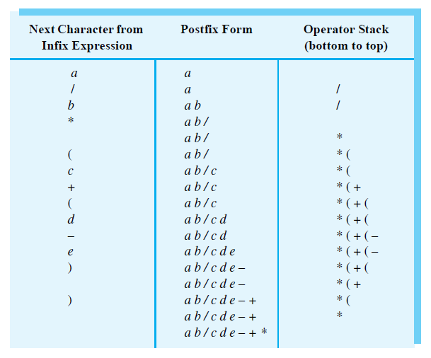
The steps in converting the infix expression a / b * (c + (d - e)) to postfix form

Slide 33
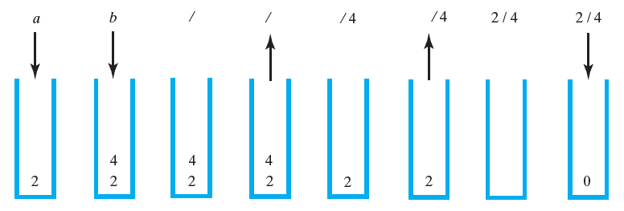
3. Evaluating Postfix Expressions
The stack during the evaluation of the postfix
expression a b / when a is 2 and b is 4

Slide 34
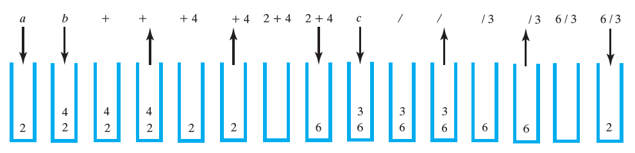
The stack during the evaluation of the postfix expression a b + c / when a is 2, b is 4, and c is 3

Slide 35
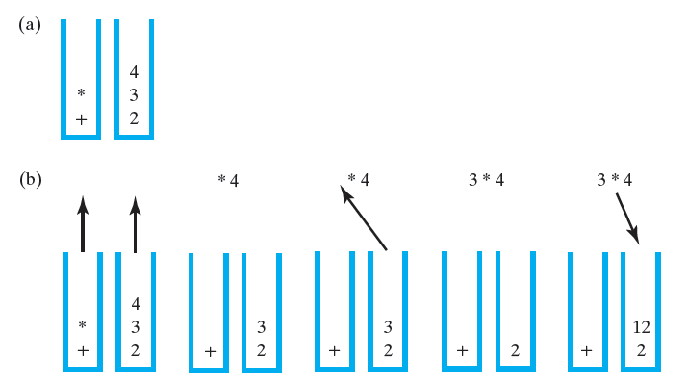
Evaluating Infix Expressions
4. Evaluating infix Expressions
Two stacks during the evaluation of a + b * c when a is 2, b is 3, and c is 4: (a) after reaching the end of the expression;
(b) while performing the multiplication;

Slide 36
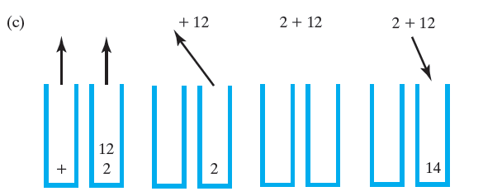
Two stacks during the evaluation of a + b * c when a is 2, b is 3, and c is 4: (c) while performing the addition

Slide 37
Group assignment 2 is topic number 2 infix to postfix

Slide 38
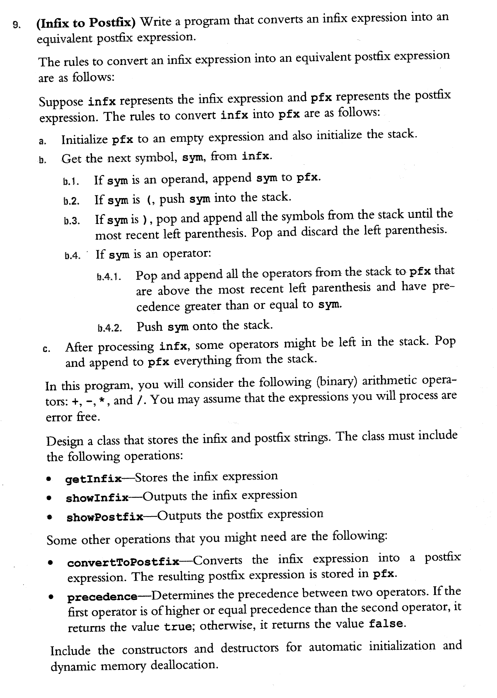

Slide 39
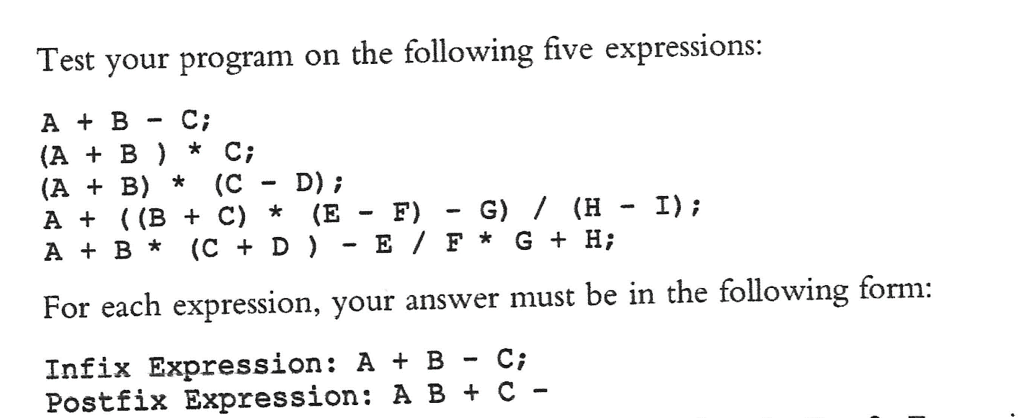
Read from file infixData.txt
A+B-C;
(A+B)*C;
(A+B)*(C-D);
A+((B+C)*(E-F)-G)/(H-I);
A+B*(C+D)-E/F*G+H;

Slide 40
#ifndef H_InfixToPostfix
#define H_InfixToPostfix
#include <string>
using namespace std;
class infixToPostfix
{
public:
void convertToPostfix();
bool precedence(char opr1, char opr2);
void getInfix(string);
void showInfix();
void showPostfix();
infixToPostfix(string = ""); //Default constructor
private:
string ifx;
string pfx;
};

Slide 41
int main(){
infixToPostfix InfixExp;
string infix;
ifstream infile;
infile.open("infixData.txt");
if(!infile){
cout << "Cannot open input file. Program terminates!!!" << endl; return 1;}
getline(infile,infix);
while(infile)
{
InfixExp.getInfix(infix);
InfixExp.showInfix();
InfixExp.showPostfix();
cout << endl;
getline(infile,infix);
}
infile.close();return 0;}

